Slide 1
A study of diarrheal deaths due to unsafe water: does a country’s wealth matter?
Robbie hockley
Danny bruzzese
Vanessa kemp

Slide 2
Access to clean water and sanitation declared a human right in 2010 by UN General Assembly.
In 2020 roughly 74% of world population had a clean, reliable drinking water source in their homes.
At least 2 billion people had a drinking water source that was contaminated with feces which poses the greatest risk for drinking-water safety.
Leads to diseases like diarrhea, cholera, dysentery, typhoid, and polio.
https://www.who.int/news-room/fact-sheets/detail/drinking-water

Slide 3
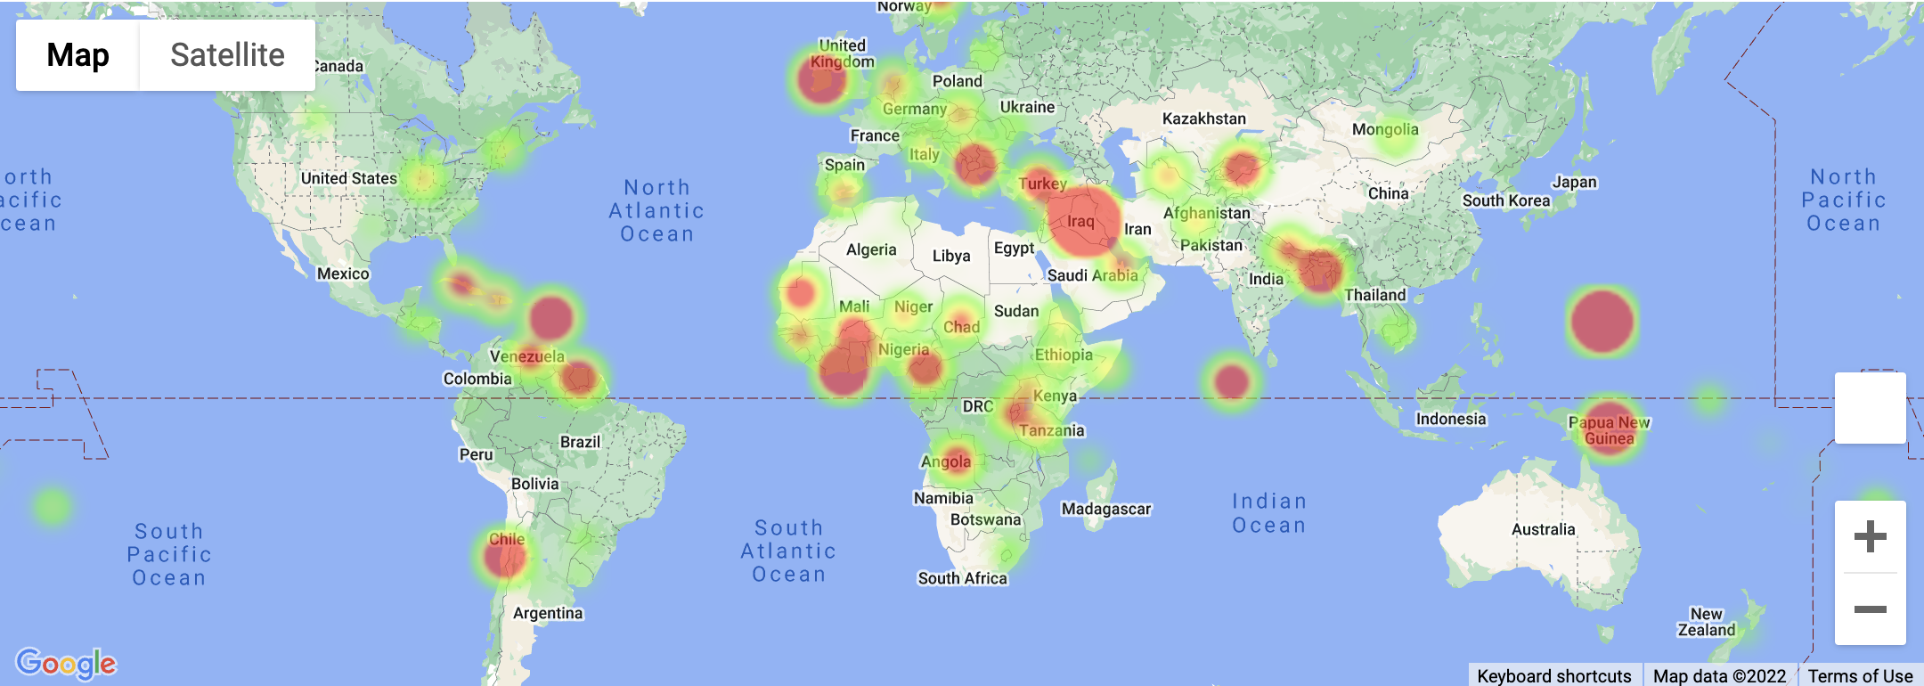
TOTAL DEATHS IN 2019 RELATED TO UNSAFE WATER SOURCES
https://ourworldindata.org/diarrheal-diseases

Slide 4
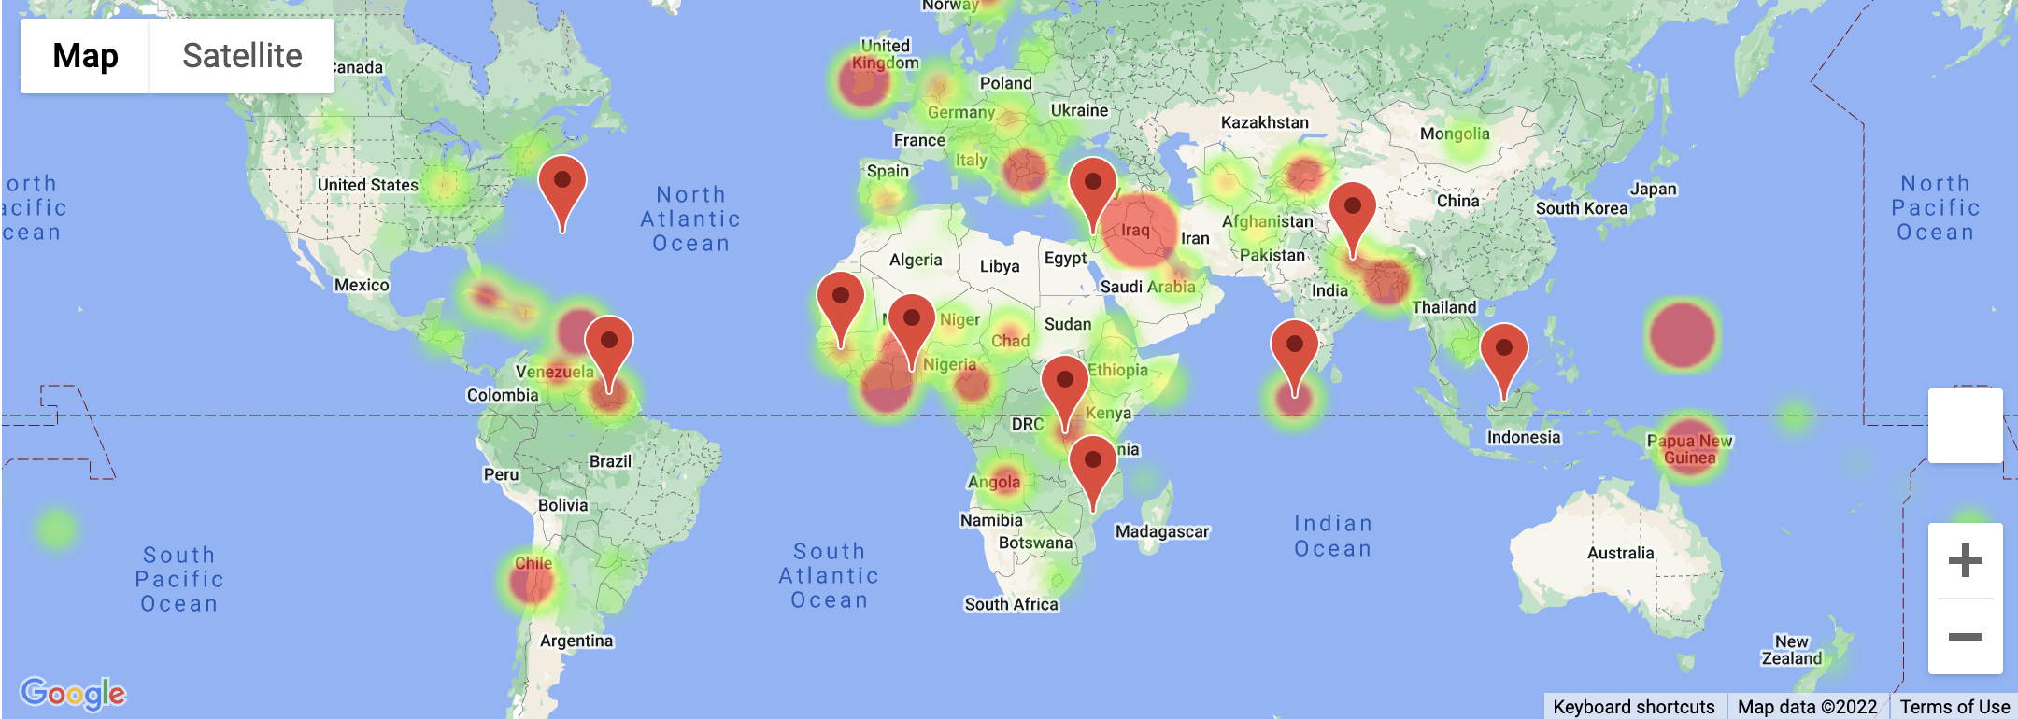
TOP 5 GDP PER CAPITA
Monaco ($175,800USD)
Luxembourg ($110,605USD)
Bermuda ($109,983USD)
Switzerland ($84,584USD)
Norway ($75,660USD)
BOTTOM 5 GDP PER CAPITA
Madagascar ($500USD)
Mozambique ($498USD)
Malawi ($467USD)
Somalia ($393USD)
Burundi ($253USD)
Average GDP per capita 2015-2019.
https://data.worldbank.org/indicator/NY.GDP.PCAP.CD

Slide 5
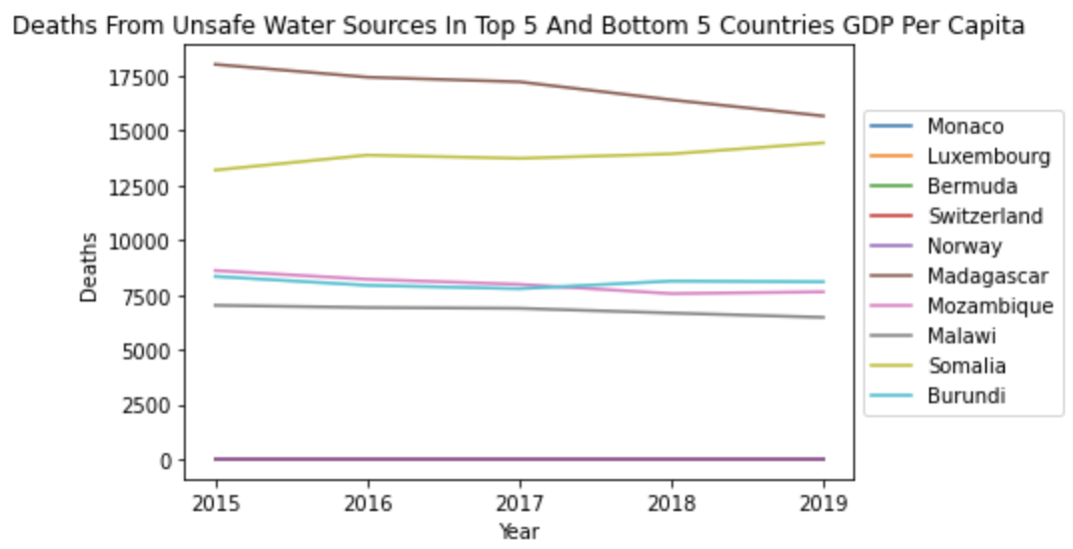

Slide 6
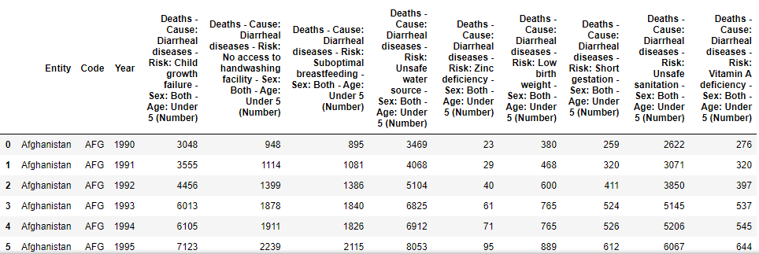
Selecting & Cleaning our Data
The data originated from Our World in Data at https://ourworldindata.org/diarrheal-diseases.
Excel and Jupyter Notebooks used to clean and sort the csv.
The five most and least developed countries via GDP per capita were chosen for analysis.

Slide 7

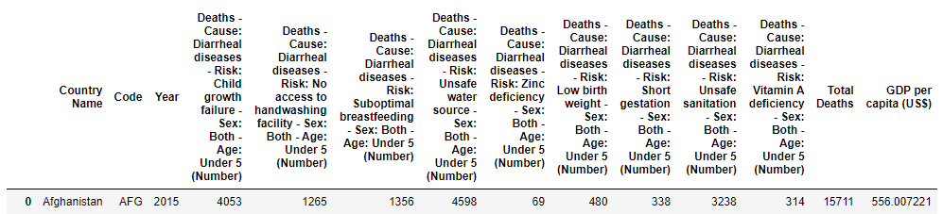
Selecting & Cleaning our Data
GDP vs GDP per capita
Why we used 2015-2019?
Stack () Function

Slide 8
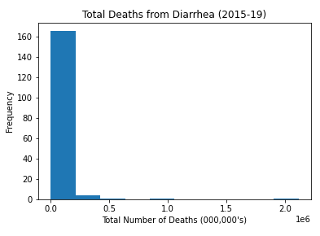
Total diarrhea deaths Histogram

Slide 9
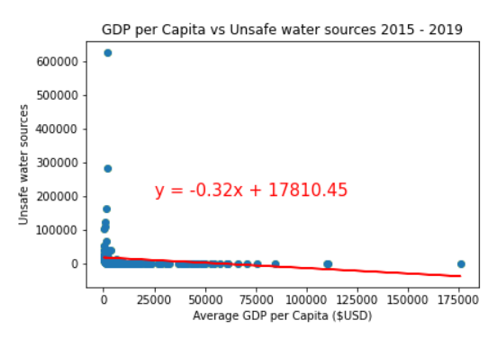
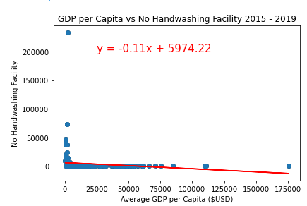
UNSAFE WATER Sources v Handwashing facility

Slide 10
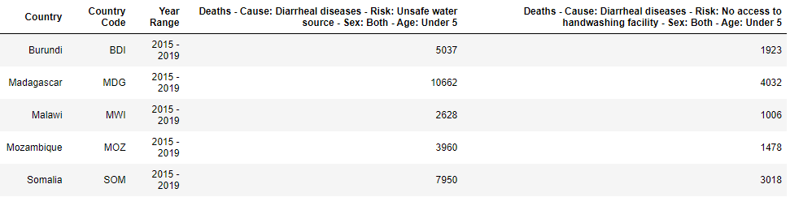
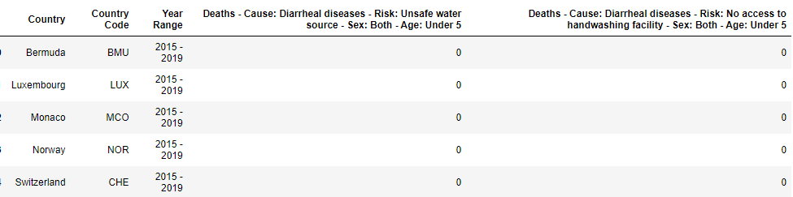
Five Least Developed Countries Calculated by GDP per Capita
Here we compare the deaths caused by unsafe water sources and no access to handwashing facilities for those aged under five in table format.
This is a five-year average ranging from 2015 to 2019.
Five Most Developed Countries Calculated by GDP per Capita
The data clearly shows the substantial risk of morbidity for children who live in under-developed countries.

Slide 11
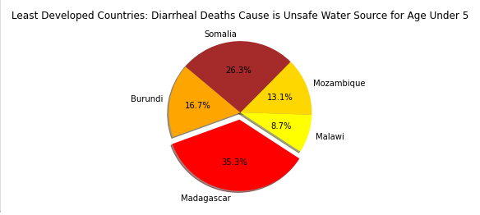
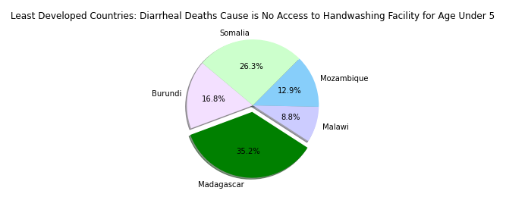
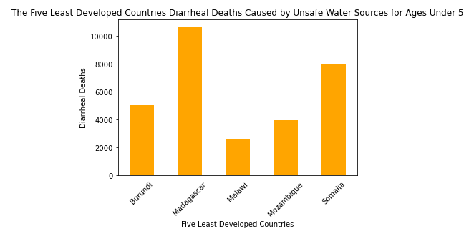
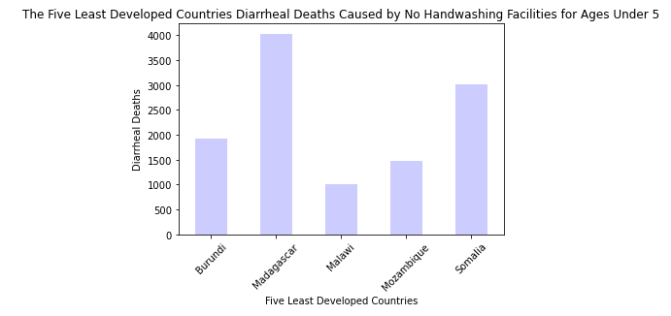

Slide 12
Hypothesis
If a country has a higher GDP per capita, then the average deaths of children due to unsafe water sources will decrease.
Null Hypothesis
There is no significant statistical difference when comparing the deaths of children due to unsafe water sources between countries of differing GDP per capita.

Slide 13
An independent t-test was conducted to further prove the stark contrast between the most developed and the least developed country population groups for each dataset.
Unsafe Water Source
No Access to Handwashing Facility
Conclusion?

Slide 14
Thank you
Robbie H
Danny B
Vanessa K
References
https://www.who.int/data/gho/info/gho-odata-api
https://ourworldindata.org/water-access
https://www.who.int/data/gho/data/indicators/indicator-details/GHO/number-of-diarrhoea-deaths-from-inadequate-water
https://ourworldindata.org/diarrheal-diseases
https://www.wateraid.org/uk/where-we-work/madagascar

